Slide 1
Employee Data Analysis using Excel
STUDENT NAME: zahir Hussain.m
REGISTER NO:312214559/50EB2F2BF0BC3B0AB3D41F9DE807CE3F
DEPARTMENT:B.COM CA
COLLEGE:ST.THOMAS COLLEGE OF ARTS AND SCIENCE

Slide 2
PROJECT TITLE
Visualizing Employee Attendance Trend with Excel Charts

Slide 3


AGENDA
Problem Statement
Project Overview
End Users
Our Solution and Proposition
Dataset Description
Modelling Approach
Results and Discussion
Conclusion
3/21/2024 Annual Review

Slide 4

PROBLEM STATEMENT
*Problem Statement
Organizations face significant challenges in effectively managing and analyzing employee attendance data. Traditional methods of tracking attendance—often involving manual spreadsheets and cumbersome reports—can lead to inefficiencies, inaccuracies, and a lack of actionable insights. As attendance data grows in volume and complexity, it becomes increasingly difficult to discern meaningful trends, identify patterns, and make informed decisions based on this information.
*pecific Problems Include:
Data Complexity and Volume:
Challenge: Managing large volumes of attendance data can overwhelm traditional spreadsheet tools, making it difficult to extract relevant insights.
Impact: This complexity often leads to delayed analysis, errors in data interpretation, and missed opportunities to address attendance issues proactively.
.

Slide 5

PROJECT OVERVIEW
*Project Overview: Visualizing Employee Attendance Trends with Excel Charts
*Project Title: Enhancing Employee Attendance Management Through Excel Chart Visualization
*Project Objective: The primary objective of this project is to develop a comprehensive solution for visualizing employee attendance trends using Excel charts. This solution aims to transform raw attendance data into clear, actionable insights that facilitate better decision-making, improve attendance management, and enhance overall organizational efficiency.

Slide 6

WHO ARE THE END USERS?
*HR Managers: To monitor attendance patterns, track absences, and ensure compliance with company policies.
*Team Leaders/Supervisors: To manage day-to-day staffing needs, identify attendance issues, and address productivity concerns.
*Operations Managers: To optimize resource allocation and adjust staffing levels based on attendance trends.
*Finance Departments: To analyze the financial impact of attendance patterns, such as overtime costs or productivity losses.

Slide 7
OUR SOLUTION AND ITS VALUE PROPOSITION
*Solution Overview
Our solution employs Excel charts to visualize and analyze employee attendance trends, offering a straightforward and powerful method for tracking and improving attendance. This solution transforms complex attendance data into clear, actionable visualizations that facilitate better management decisions and strategic planning.
*Value Proposition
**1. Enhanced Insight and Decision-Making:
Data Visualization: Transforms raw data into visual insights, making it easier to understand complex attendance patterns.
Trend Identification: Helps in identifying trends and anomalies, enabling proactive decision-making to address attendance issues.

Slide 8
Dataset Description
*Kaagle-employee dataset
*26 feature
*9 featuresEmp id- numerical
*Fn- text
*Ln- text
*Business unit- text
*Gender-male, female
Performance score- text

Slide 9

THE "WOW" IN OUR SOLUTION
IFS(Z8>=5,”VERY HIGH”,Z8>=4,HIGH”,Z8>=3,”MED’,TRUE,”LOW”)
3/21/2024 Annual Review
9

Slide 10
MODELLING
Data Collection
a. Gather Data:
Employee Details: Name, ID, Department, etc.
Attendance Records: Dates, Attendance Status (Present, Absent, Late, etc.), and Reasons for Absence.
b. Data Organization:
Spreadsheet Layout: Use columns for Date, Employee ID, Employee Name, Department, Attendance Status, and any other relevant metrics.
2. Data Preparation
a. Clean Data:
Remove duplicates, handle missing values, and correct any inaccuracies.
b. Format Data:
Ensure dates are in a consistent format.
Categorize attendance status for easier analysis (e.g., Present, Absent, Late).
c. Create Pivot Tables:
Summarize data by Employee, Department, or Time Period to analyze trends and patterns.
10

Slide 11
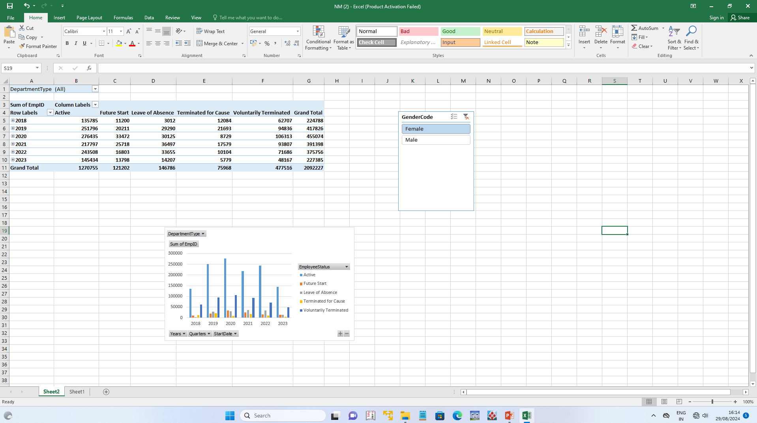
RESULT
Visualizing Employee Attendance Trend with Excel Charts

Slide 12
RESULTS
Visualizing Employee Attendance Trend with Excel Charts
12

Slide 13
conclusion
*In conclusion, effectively visualizing employee attendance trends in Excel involves a strategic approach to data organization and presentation.
*By using pivot tables and dynamic charts such as line, column, and stacked column charts, you can clearly illustrate attendance patterns, compare different data points, and highlight trends over time.
*This approach not only simplifies complex data but also enables more strategic planning and resource allocation.
*Regularly updating and analyzing these visualizations ensures that attendance trends are monitored proactively, allowing for timely interventions and fostering a more productive and well-managed work environment.

